Slide 1

Cybersecurity Awareness Chatbot
Boikanyo Maleka
ST10472664

Slide 2
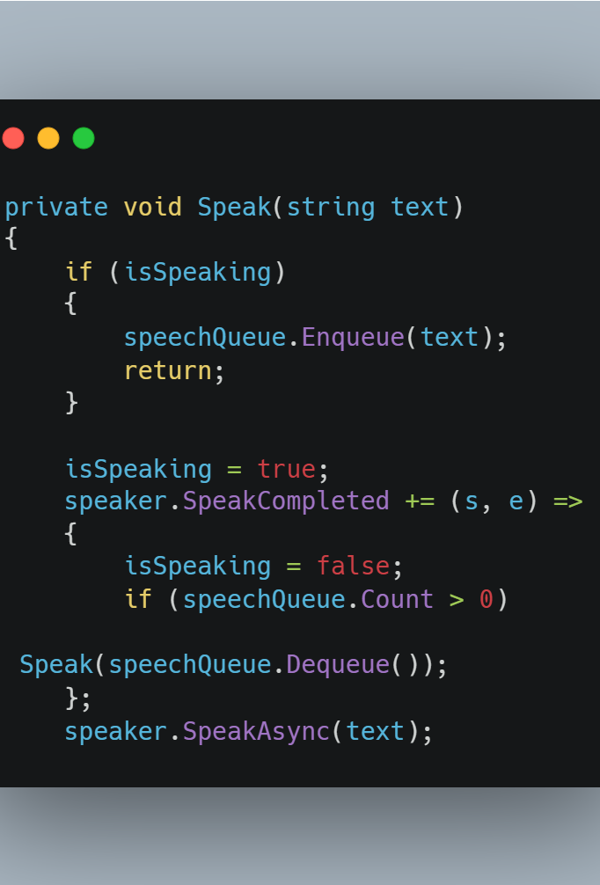

The Speech Synthesis Queue
Checks a boolean flag (isSpeaking) to see if the bot is currently talking.
If busy, enqueues the text into a Queue<string>.
Uses a SpeakCompleted event handler to process the queue sequentially.

Slide 3
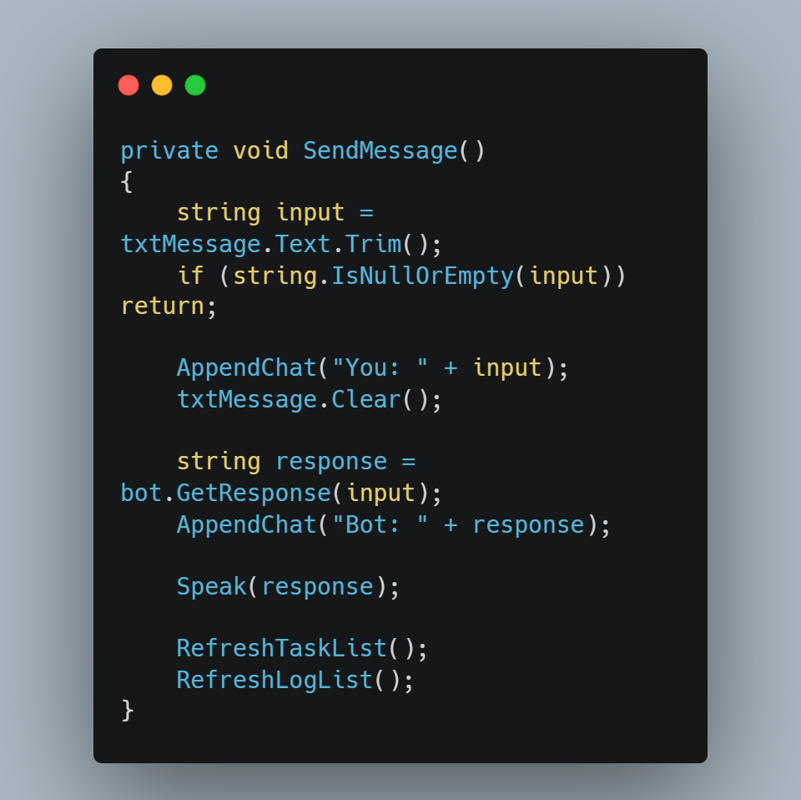


Capturing and Routing User Input
Validates input to reject empty strings.
Updates the UI TextBox (appends user text, clears input).
Passes the string to bot.GetResponse().
Updates the UI with the bot's response and triggers the speech queue.

Slide 4
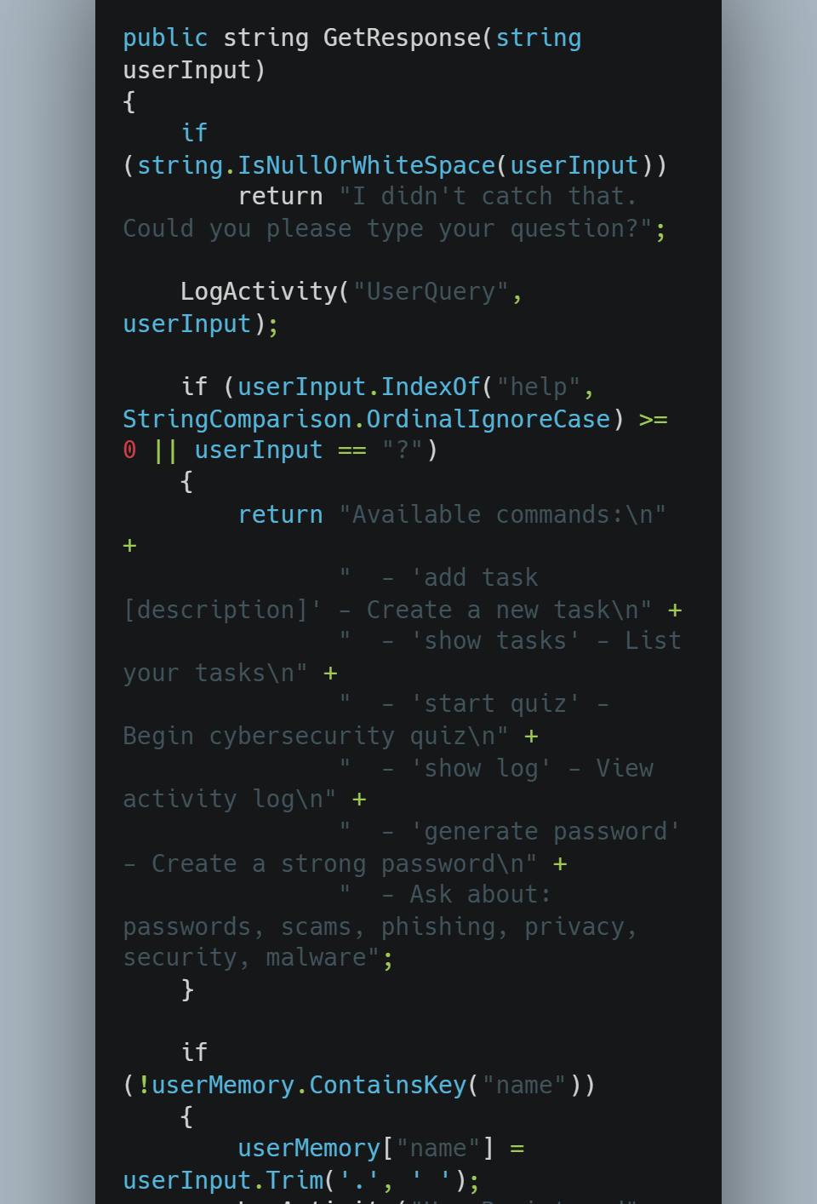

Natural Language Processing Router
Acts as the central "traffic cop" for all incoming text.
Uses a cascading series of conditional checks.
Checks system commands first, then user memory, then feature commands.
Falls back to semantic analysis if no hard commands are matched.

Slide 5
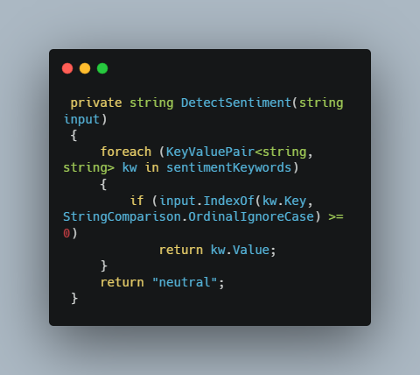
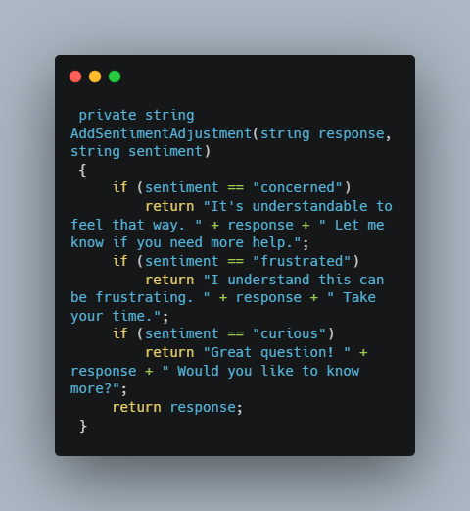

Keyword Detection & Sentiment Analysis
DetectSentiment: Iterates through a dictionary of emotion keywords to return a state (e.g., "concerned").
FindKeywordResponse: Matches input to cybersecurity topics and selects a random response.
AddSentimentAdjustment: Prepends an empathetic phrase to the base response based on the detected mood.

Slide 6
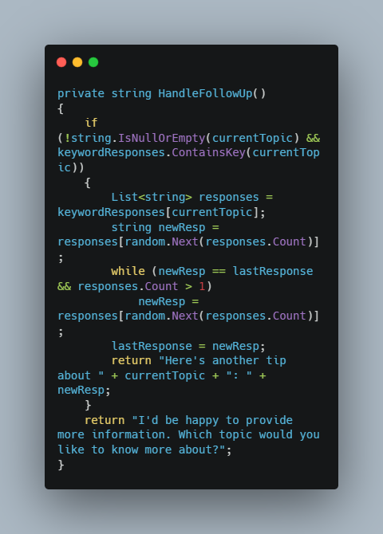

Maintaining Short-Term Memory
Checks the currentTopic variable set during the previous interaction.
Fetches a new random response from that specific topic's list.
Uses a while loop to ensure the new response is not identical to the lastResponse.

Slide 7
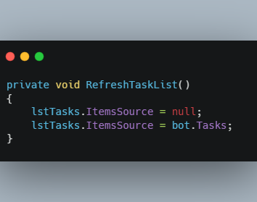

Forcing UI Updates in WPF
Sets the ItemsSource property of the ListBox to null.
Immediately reassigns the ItemsSource to the updated collection.
Forces the WPF framework to re-render the collection.

Slide 8
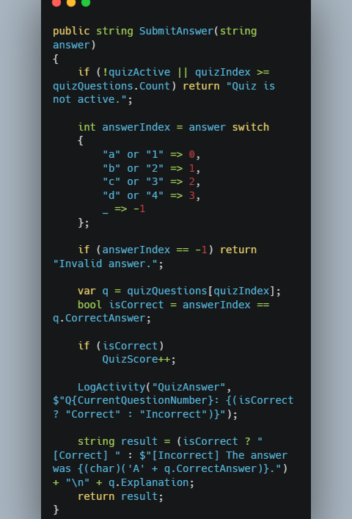

Managing Quiz Flow and State
Maps the user's string input ("A") to an integer index (0) using a switch expression.
Compares the index to the CorrectAnswer property of the current question.
Increments the QuizScore if matched.
Logs the result to the activity tracker.

Slide 9
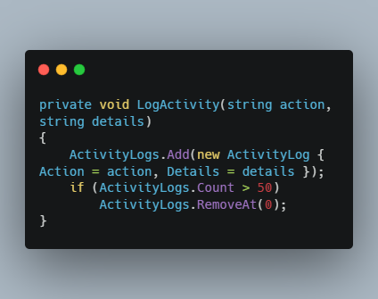

Activity Tracking & Audit Trail
Creates a new ActivityLog object with the current DateTime.Now.
Adds the object to the ActivityLogs list.
Checks the list count; if it exceeds 50, it removes the oldest item.

